Slide 1
LHS JV Drill and Panther Pride Drill Team
TRYOUT MEETING

Slide 2
What are JV Drill and Panther Pride?
JV Drill Team and Panther Pride are spirit organizations. Their goal is to support the student body and promote school spirit. Drill Team members also serve as school ambassadors within our community.
Drill Team aims to promote the art of dance performance through teamwork while creating a positive and fun learning environment.
Drill Team aims to promote self discipline and self confidence.
Drill Team aims to promote leadership qualities, respect for self and others, and time management skills.

Slide 3
What will I be involved in as a member?
As a member you will perform at LHS football/basketball games, and pep rallies. Drill Team will also attend competition and perform in Panther Pride’s annual Christmas Spectacular and Spring Show.
Participation is also required at various community events, volunteer opportunities, fundraisers, and parades.
Summer camp and practices are mandatory. Camp will be held the second week of August. Panther Pride may be asked to attend mandatory practices the first week of August as well.
Practices will take place before school and during first period for Panther Pride as well as Tuesdays and Thursdays after school. Practices will take place during second period and Mondays after school for JV Drill.

Slide 4
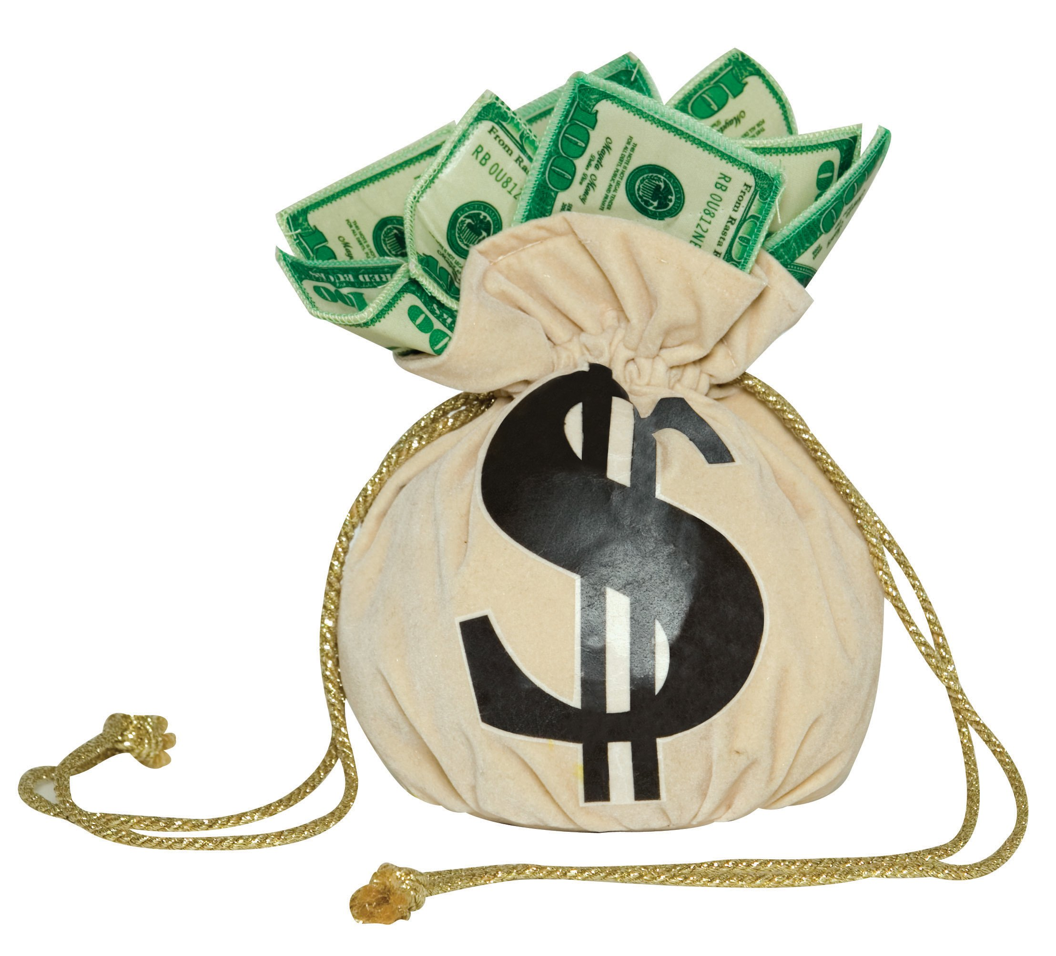
What are the costs involved?
Drill Team members are responsible for purchasing practice clothes, shoes, bags, team shirts, uniforms, poms, camp fees, etc. Initial cost may run up to $600 for JV Drill and $1000 for Panther Pride. Many items if taken care of can be used the next year. An itemized expense list will be given to parents upon scheduled uniform fittings.
LISD offers a scholarship program for those who qualify. Scholarship applications will be available after tryouts.
Any member failing to complete payments by the due dates will not be allowed to remain on the team. Payment dates are listed on the front page of the tryout packet.

Slide 5
Drill Team Constitution
Certain standards are necessary for the integrity of any organization. Each and every member of the Drill Team should be a leader within the school and set a good example at all times.
LHS Drill Teams will follow a Code of Conduct and Constitution. The parent and student must agree to and sign the Code of Conduct and Constitution in order to tryout to be on the team.

Slide 6
Eligibility
JV Drill Team Tryouts are open to 8, 9, and 10 grade students currently enrolled and attending Lufkin Middle School or Lufkin High School.
Panther Pride Tryouts are open to 9, 10, and 11 grade students currently enrolled and attending Lufkin High School.
Drill Team Hopefuls must be passing all classes in order to attend after school practices and tryouts. Grade waivers will not be given for tryouts.
If a Drill Team Hopeful receives three or more discipline referrals they will not be eligible to tryout.
If a student is placed in alternative school during the tryout process they will not be allowed to tryout.
After tryout applications are received, grades and discipline referrals will be checked. Ineligible candidates will be notified.

Slide 7
Important Dates
Applications are due by 4:00pm on March 29th , absolutely no late applications will be accepted. At LMS applications are due to the office of Mr. Gomez, at LHS applications are due to Mrs. White in Room C120.
For JV Drill, mandatory tryout clinics will be held on April 9, 23, 24, and 25 from 4:15-5:30pm in the LHS Purple Gym.
For Panther Pride, mandatory tryout clinics will be held on April 9 and 26 from 4:15-6:00 in the LHS Purple gym.

Slide 8
Important Dates Continued
JV Drill Tryouts will be held on Saturday April 28th at approximately 1:00pm (following Panther Pride Officer tryouts)
Panther Pride tryouts will be held on Friday April 27th at 5:00pm
All tryouts will be held in the LHS Purple Gym.

Slide 9
Tryout Clinics
Hopefuls will need to dress in appropriate dance attire such as jazz shoes, leggings and shirts that fit. Please no bare midriffs and no boy shorts.
Hair is to be worn in a ponytail, no jewelry and no gum.
A jazz dance, a technique combination and a kick combination will be taught at the clinics. Technique and kick combinations can be found in the tryout packet.
Hopefuls will work with Panther Pride Officers and Directors during the clinics.
Clinics are closed to the public.

Slide 10
TRYOUTS
Hopefuls will wear all black dance attire.
Hair will be worn in a ponytail with a white bow.
A number will be worn for judging purposes to ensure impartiality.
Hopefuls will tryout in groups of 3 or 4.
Hopefuls will perform the kick, technique, and jazz combinations taught at the tryout clinics.
Tryouts are closed to the public.
A scoresheet can be found in the tryout packet.

Slide 11
TRYOUTS
Judges shall be selected in advance and approved by an administrator.
Olympic style scoring will be used with the five judges. The highest and lowest scores will be dropped and the sum of the remaining three judges will be tallied.
There is no set number of candidates who can make the team, however it is dependent on scores and breaks in scores.
Results will be posted on the LISD website by tryout number. The judges decisions are final and are not grounds for the formal grievance process.
Judges scores carry 100% of the points!

Slide 12
LHS Drill Team
Lufkin ISD is excited to present our students with this opportunity!!
We look forward to sharing this experience with you.
If you have any questions please contact Mrs. Patricia White, our Student Activities Director at 633-7838 or the Drill Team Office at 630-4160.

